Slide 1
Setup Instructions

Slide 2
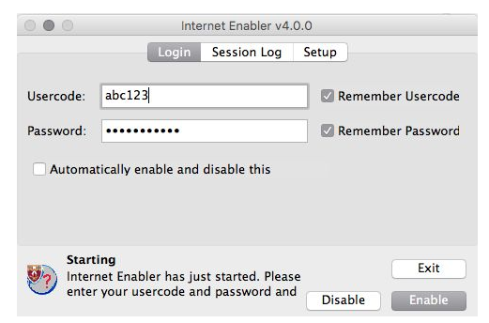
Enable Internet
Search for ‘internet’, then run the Python Internet Enabler.
Enter your username and password and click ‘enable’.

Slide 3
Download the Workshop
Start a terminal
Type
>>cd ~
>>git clone https://github.com/maitchison/tf_workshop
>>cd tf_workshop
>>jupyter notebook
Then click “Tensorflow Workshop (blank).ipynb”
(if it breaks… pip install ipython --user –upgrade)

